Slide 1
DATA ANALYST INTERNSHIP
TASK 1 : HR DATA ASSESSMENT
BY : ADITYARAJ BHANDARE

Slide 2
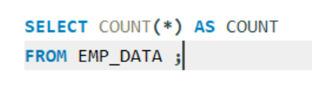
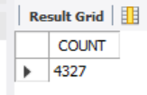

1. Retrieve the total number of employees in the dataset.

Slide 3

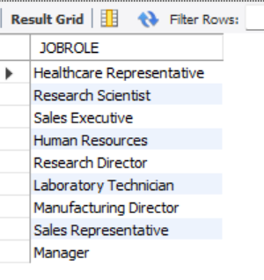
2. List all unique job roles in the dataset.

Slide 4


3. Find the average age of employees.

Slide 5

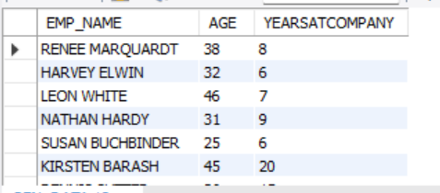
4. Retrieve the names and ages of employees who have worked at the company for more than 5 years.

Slide 6
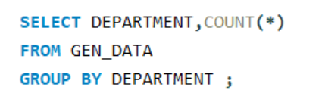
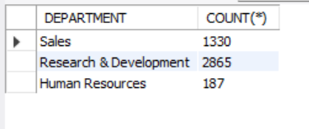
5. Get a count of employees grouped by their department.

Slide 7
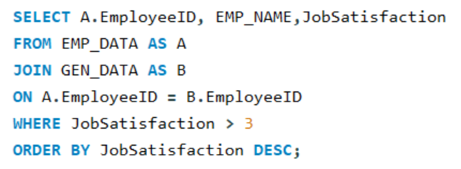
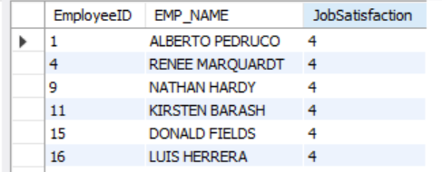
6. List employees who have 'High' Job Satisfaction.

Slide 8
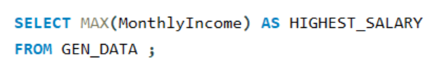

7. Find the highest Monthly Income in the dataset.

Slide 9
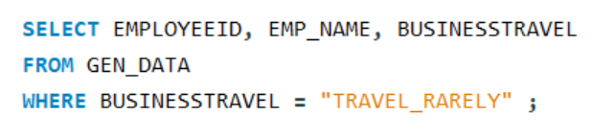
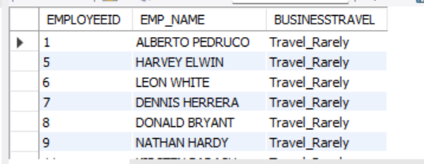
8. List employees who have 'Travel_Rarely' as their BusinessTravel type.

Slide 10

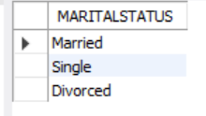
9. Retrieve the distinct MaritalStatus categories in the dataset.

Slide 11
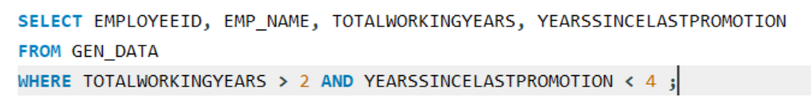
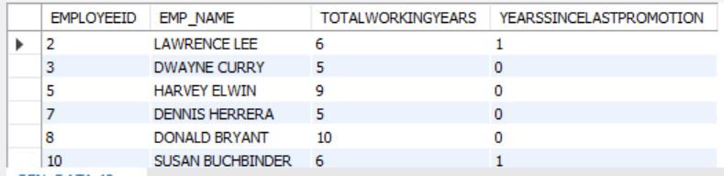
10. Get a list of employees with more than 2 years of work experience but less than 4 years in their current role.

Slide 12
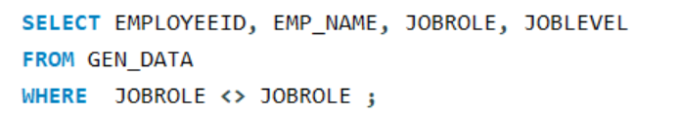
11. List employees who have changed their job roles within the company
(JobLevel and JobRole differ from their previous job).

Slide 13
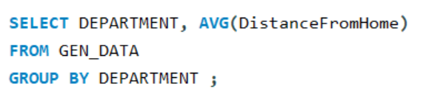
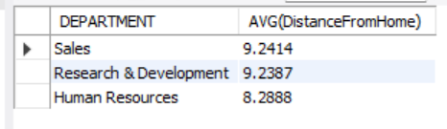
12. Find the average distance from home for employees in each department.

Slide 14
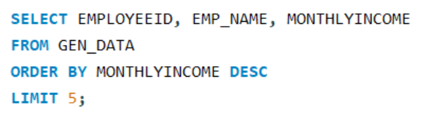
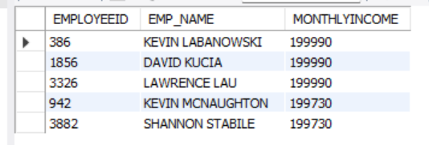
13. Retrieve the top 5 employees with the highest Monthly Income.

Slide 15
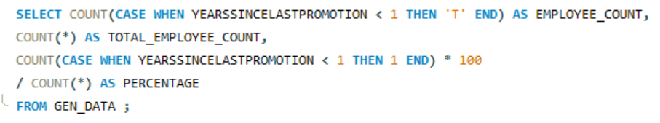

14. Calculate the percentage of employees who have had a promotion in the last year.

Slide 16
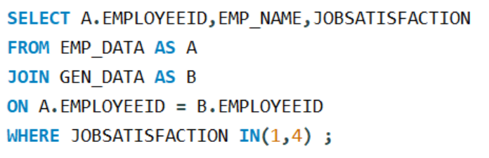
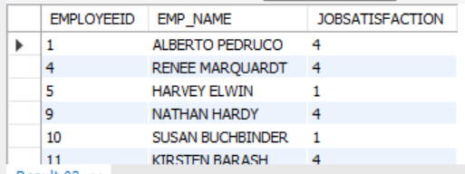
15. List the employees with the highest and lowest Environment Satisfaction

Slide 17
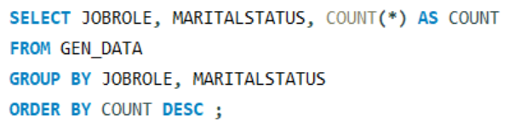
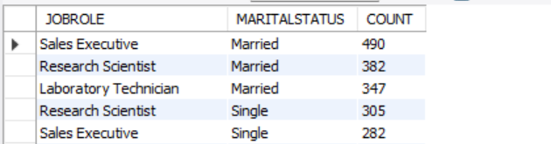
16. Find the employees who have the same JobRole and Marital Status.

Slide 18
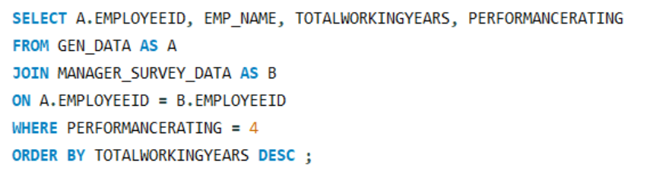
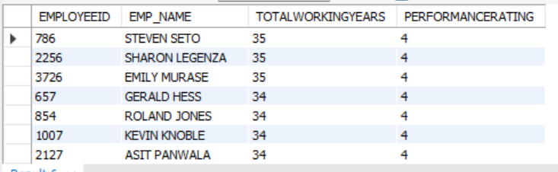
17. List the employees with the highest TotalWorkingYears who also have a PerformanceRating of 4.

Slide 19
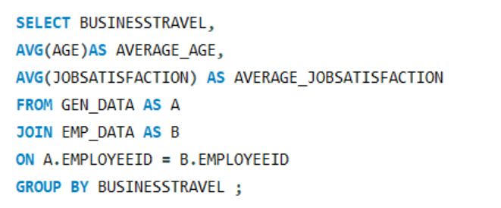
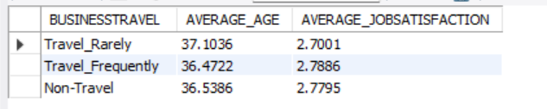
18. Calculate the average Age and JobSatisfaction for each BusinessTravel type.

Slide 20
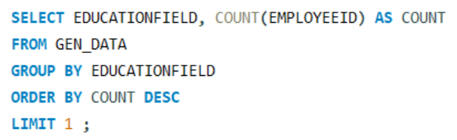

19. Retrieve the most common EducationField among employees.

Slide 21
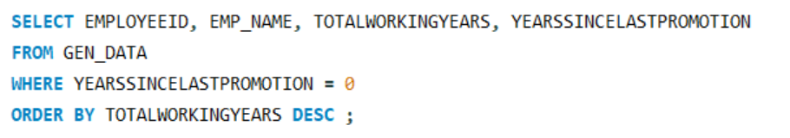
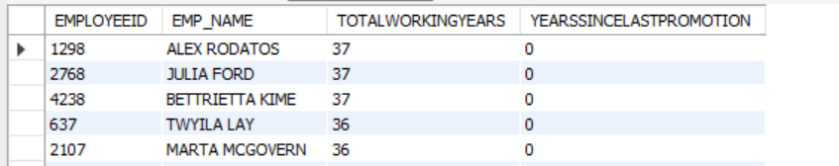
20. List the employees who have worked for the company the longest but haven't had a promotion.

